Slide 1

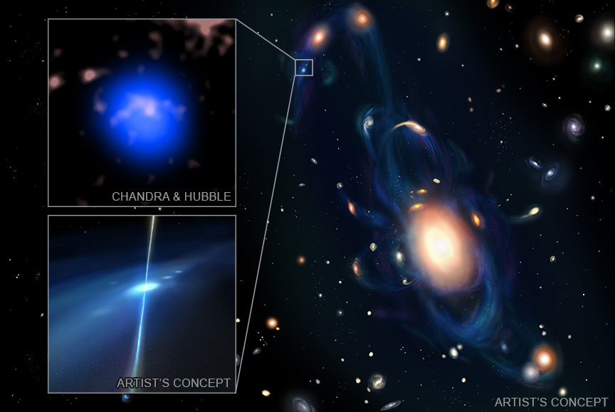

CHANDRA SCIENCE HIGHLIGHT: March 2026
National Aeronautics and Space Administration
NASA Discovers Crash of Extreme Stars in Unexpected Site
Astronomers have spotted a collision between two neutron stars in an environment unlike any other seen before, using NASA’s Chandra X-ray Observatory and other telescopes.
This event called GRB 230906A is likely seen in a tiny galaxy in a stream of gas located about 4.7 billion light-years from Earth. Such events are usually found in much larger galaxies.
The discovery of this neutron star collision may explain the presence of gold and platinum in the outer regions of galaxies.
To find this event and identify its true nature, astronomers used several other NASA telescopes besides Chandra, including Fermi, Swift, and Hubble.
Distance estimate: 4.7 billion light-years from Earth
Credit: X-ray: NASA/CXC/Penn State Univ./S. Dichiara; IR: NASA/ESA/STScI; Illustration: ERC BHianca 2026 / Fortuna and Dichiara, CC BY-NC-SA 4.0; Image Processing: NASA/CXC/SAO/P. Edmonds
Instrument: ACIS
Reference: Dichiara, S. et al., 2025, ApJL, 999, 442
More information: The detailed caption and other material are here: https://chandra.si.edu/photo/2026/nsmerger/
This graphic depicts the likely discovery of a collision between two neutron stars, made by Chandra and other telescopes. Two artist’s illustrations — one in the main panel and the other on the bottom left — depict what astronomers think happened in the collision. Known as GRB 230906A, this event was first picked up by NASA’s Fermi Gamma-ray Space Telescope in September 2023. Astronomers then used the Neil Gehrels Swift Observatory to provide a more accurate position followed by observations with Chandra and the Hubble Space Telescope. The Chandra data, shown in blue in the inset to the upper left of the graphic, gave the researchers an even more accurate position for the GRB, and once Chandra told them exactly where to look, the researchers then used Hubble (shown in pink) to reveal a tiny, extremely faint galaxy at that position.
The Chandra X-ray Center is operated for NASA by the Smithsonian Astrophysical Observatory

