Slide 1

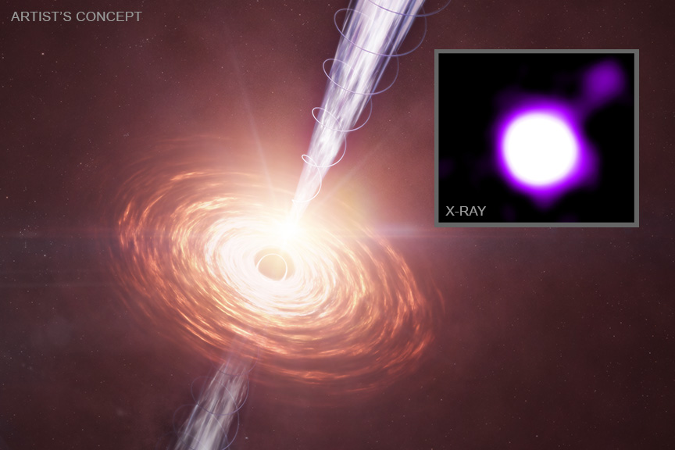

Chandra Science Highlight
NASA's Chandra Sees Surprisingly Strong Black Hole Jet at Cosmic "Noon"
Scientists have discovered a powerful jet blasting away from a black hole about 3 billion years after the big bang. This jet is so distant that astronomers can only detect it because its particles boost photons in the cosmic microwave background to X-ray energies.
NASA’s Chandra X-ray Observatory detected this black hole and jet plus another almost equally distant black hole and jet.
One of the jets is surprisingly powerful, with its particles carrying roughly half as much energy as the intense light from hot gas orbiting the black hole.
Combining X-ray with radio data from the VLA allows astronomers to investigate how black holes shaped their surroundings during a critical era – called “cosmic noon” – when galaxy and black hole growth were at their peak.
Distance estimate: 11.6 billion light-years
Credits: X-ray: NASA/CXC/CfA/J. Maithil et al.; Illustration: NASA/CXC/SAO/M. Weiss; Image Processing: NASA/CXC/SAO/N. Wolk
Instrument: ACIS
Reference: Maithil, J. et al., 2025., ApJ., Accepted; 246th AAS Meeting.
More information: The detailed caption and other graphics materials are here:
https://chandra.harvard.edu/photo/2025/j1610/
The main graphic is an artist’s concept showing material in a disk that is falling towards a supermassive black hole. Jets are blasting away from the black hole towards the upper right and lower left. The black hole is located 11.6 billion light-years from Earth when the density and energy of the cosmic microwave background (CMB), the leftover glow from the big bang, were much higher than they are now. As the electrons in the jets fly away from the black hole, they move through the sea of CMB radiation and collide with microwave photons. These collisions boost the energy of the photons up into the X-ray band allowing them to be detected along the jet by Chandra - shown in the inset - even at its great distance.
The Chandra X-ray Center is operated for NASA by the Smithsonian Astrophysical Observatory
June 2025

